Slide 1




Trainer- Anubhav Oberoy

Slide 2


SAP Signavio Training
Anubhav Oberoy
Day-1

Slide 3
Agenda Unit-1
Course Overview
Challenges and opportunities transforming to SAP S/4HANA
From Strategy to Execution: how to Transform successfully
Process-driven and solution-driven transformations
How SAP Signavio Training drives SAP S/4HANA transformations

Slide 4
UNIT:1- Introduction to Business Transformation with SAP
1:1-Course Overview
Notes:
https://unsplash.com/photos/L0nipfx-Ry4

Slide 5



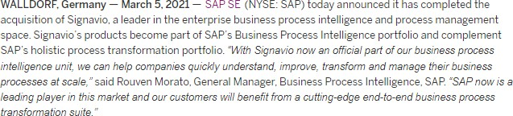


The story behind SAP Signavio
Course overview
2009
2021
Signavio = Italian word “Segnavia” meaning signpost. Because it was
Signavio’s goal from the very beginning
to help businesses navigate change
Siggi the jumping gazelle
Oryx: Codename of the Signavio Prototype developed at HPI Potsdam

Slide 6
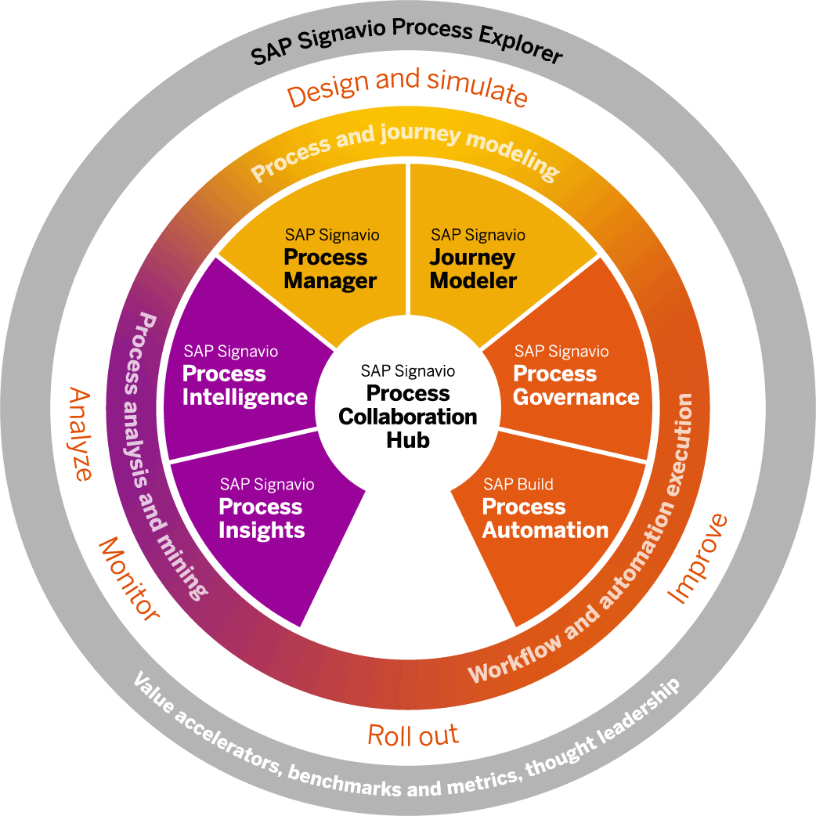
SAP Signavio Process Transformation Suite
Course overview
In a nutshell:
Cloud-based process management platform
Enables you to understand, improve, and
transform your business processes
Single source of truth built for continual process transformation
Look for yourself:
signavio.com/products/process-transformation-suite signavio.com/get-started-rise-with-sap

Slide 7

Course Overview
Course structure walkthrough
20+ hours of content in total, each week consists of a certain amount of units.
The topics build on each other thematically as well as with regard to the difficulty level.
The course structure is aligned with our suggested SAP S/4HANA transformation methodology.
The course contents must not necessarily be applied in their entirety in order to achieve a successful SAP S/4HANA transformation.
Notes:
https://unsplash.com/photos/CPs2X8JYmS8

Slide 8
Training Overview
1
2
Introduction
BPM
Fundamentals
Introduction to
Business Transformation with SAP
3
4
1.1
Course overview
Analyze and Enhance
Design
1.2
Challenges and opportunities transforming to SAP S/4HANA
5
From Build
To Enablement
1.3
From strategy to execution: how to transform successfully
6
Process-driven and
solution-driven transformations
Continuous Improvement
1.4
1.5
How SAP Signavio Training drive SAP S/4HANA transformations
Notes:
https://unsplash.com/photos/CPs2X8JYmS8

Slide 9
UNIT:1- Introduction to Business Transformation with SAP
1.2- Challenges and Opportunities Transforming to SAP S/4HANA

Slide 10
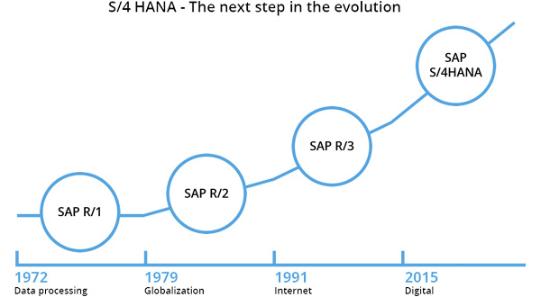
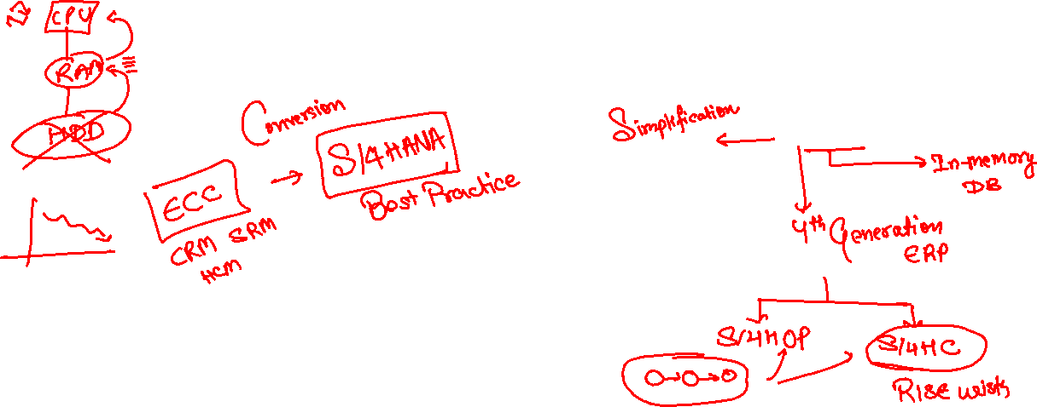
Notes:
SAP S/4HANA is a new product line for SAP next-generation Digital Core business suite, which is completely separated from the classical SAP Business Suite. Therefore we use the term “system conversion” and not the “upgrade” for the migration from the classic ERP system running on any DB to the S/4HANA system. This is because you move from one SAP product (Business Suite) to the completely new one (S/4HANA), built on the new architecture and data models, containing renewed applications and new UI technology (SAP Fiori).
Since years SAP customers invested heavily into custom ABAP code developments related to the SAP Business Suite. Therefore during system conversion from the classic SAP ERP system running on any DB to SAP S/4HANA custom ABAP code needs to be adapted for SAP S/4HANA.

Slide 11

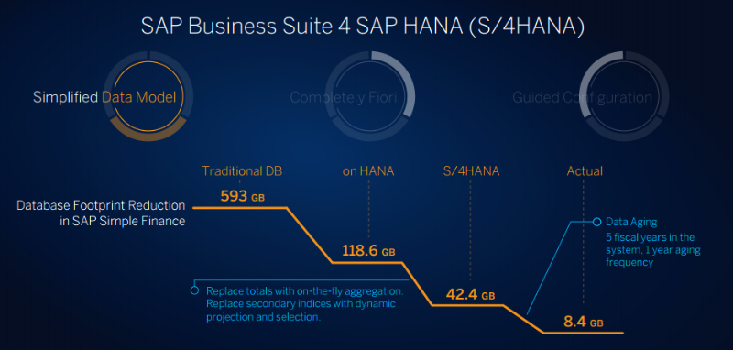
https://rapid.sap.com/bp/

Slide 12
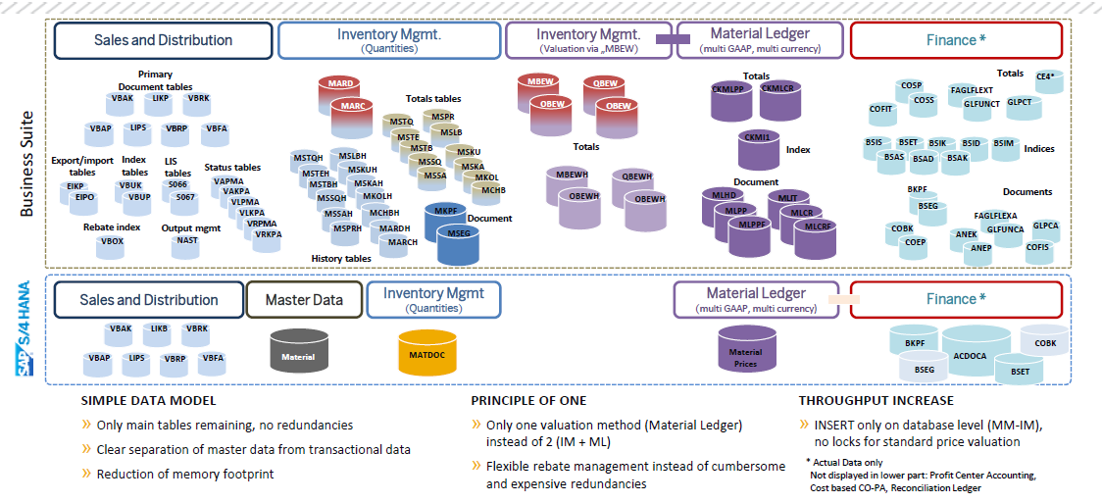

Slide 13


Challenges and opportunities transforming to SAP S/4HANA
Change is Inevitable

Slide 14










Challenges and opportunities transforming to SAP S/4HANA
Irrespective of your transformation path, your business processes will change
Current State
Future State
SAP Customer
Non-SAP Customer
Transition Path
SAP S/4HANA Cloud (Private, Public)
SAP S/4HANA
On-Premise
New Implementation
System Conversion
Selective Data Transition

Slide 15


How does an organization ensure that the transformation adds value?

Slide 16
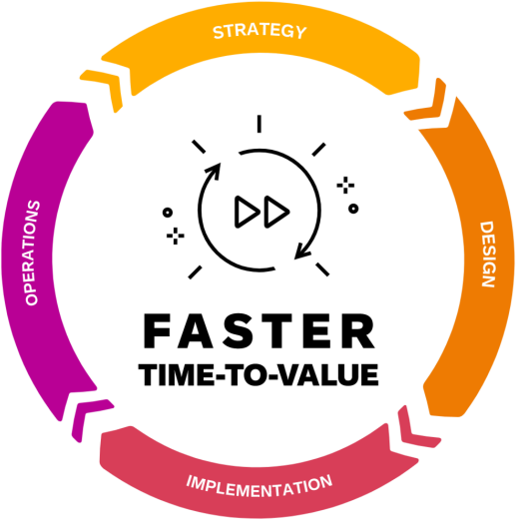

Challenges and opportunities transforming to SAP S/4HANA
How do you ensure that your transformation adds value?
Gain Process Transparency
Discover blockers that prevent processes from running efficiently. Understand if certain organizational units perform better than others.
Implement new SAP S/4HANA innovations. Ensure training & enablement of all affected
stakeholders.
Implement process improvements
Validate and quantify value-add
Aligment &
Communication
Assess process improvement potential with
stakeholders.
Ensure management buy-in and prioritization.
Leverage suitable SAP S/4HANA innovations to design and improve processes. Realize immediate value with changes prior to the move to SAP S/4HANA.
Design processes to realize the value

Slide 17

How does an organization make the transformation as fast as possible?

Slide 18
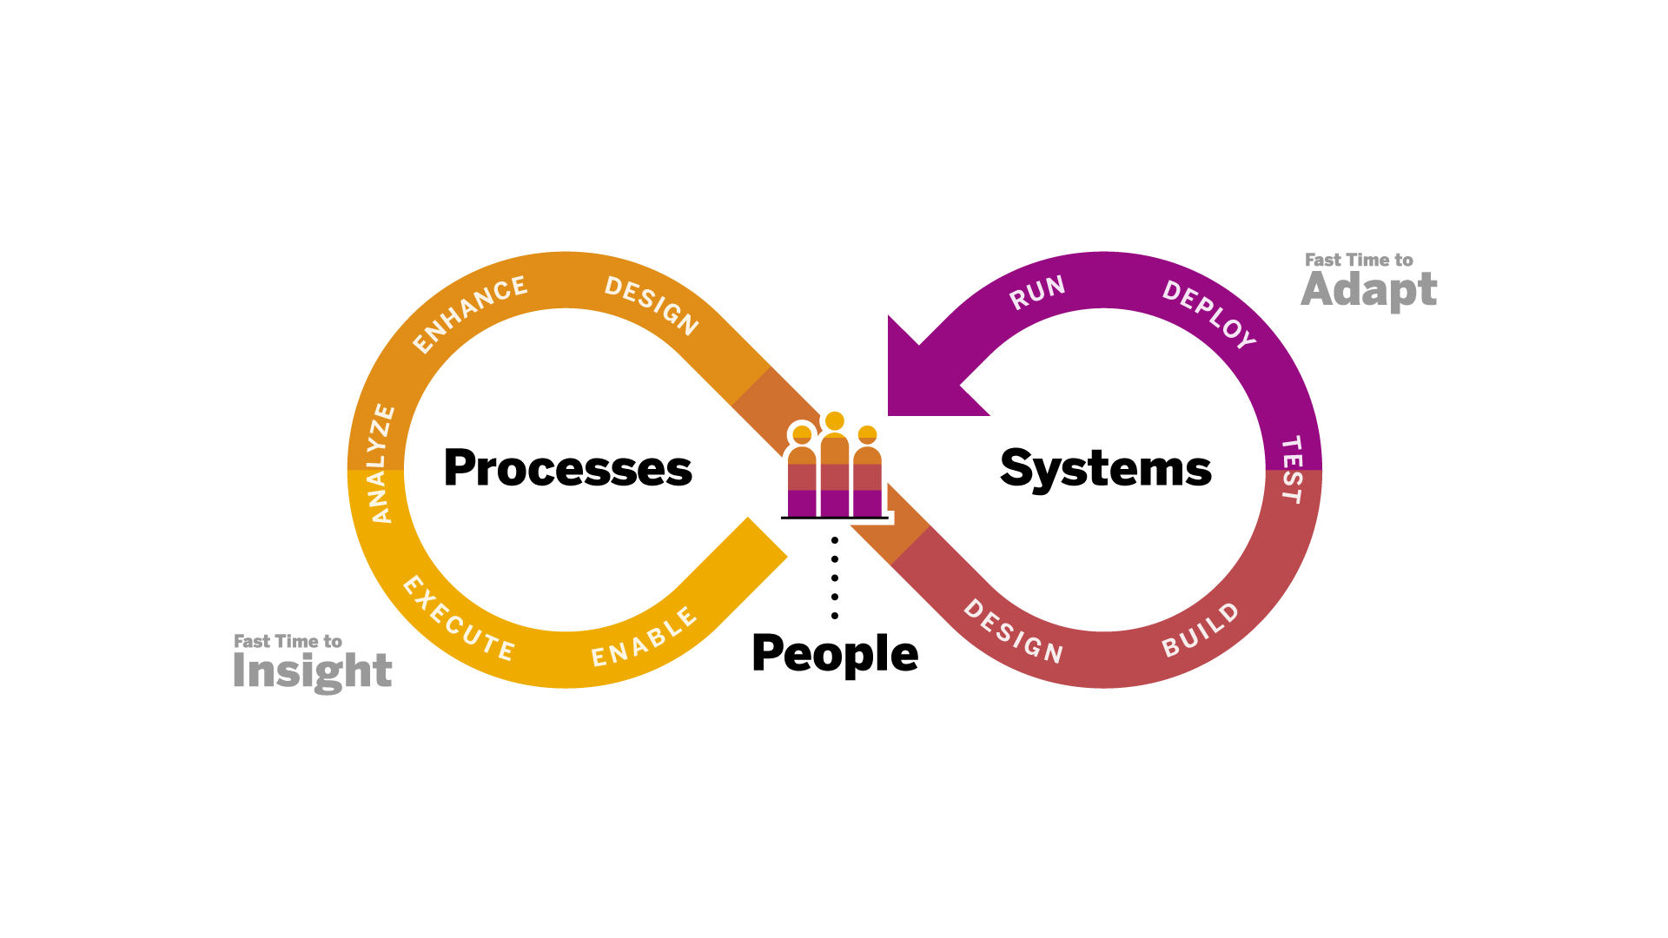
Challenges and opportunities transforming to SAP S/4HANA
How does an organization make their transformation as fast as possible?

Slide 19


How does an organization ensure that change is manageable?
© 2023 SAP SE or an SAP affiliate company. All rights reserved. ǀ PUBLIC 9

Slide 20






How does an organization ensure that change is manageable?
Challenges and opportunities transforming to SAP S/4HANA
Transformation approach
Break down silos
Transformation targets
Sufficient resources
Management Buy-In
Change management and enablement

Slide 21

SAP S/4HANA transformations are business initiatives

Slide 22

Unit:1- Introduction to Business Transformation with SAP
1.3- From Strategy to Execution: How to Transform Successfully

Slide 23




From strategy to execution: how to transform successfully
Four dimensions to transform successfully
Business Strategy
Processes
Systems
People
Execute on the
company’s business strategy to enable business outcomes such as increased competitiveness, agility, resilience, transparency, collaboration, and governance.
Ensure customer value- adding, efficient, reliable, and scalable business operations by driving process optimization and harmonization in line with compliance and regulatory requirements.
Leverage technology innovation and automation capabilities across core applications and extensibility platforms.
Collaboration breaks down barriers and is the prerequisite for change.

Slide 24
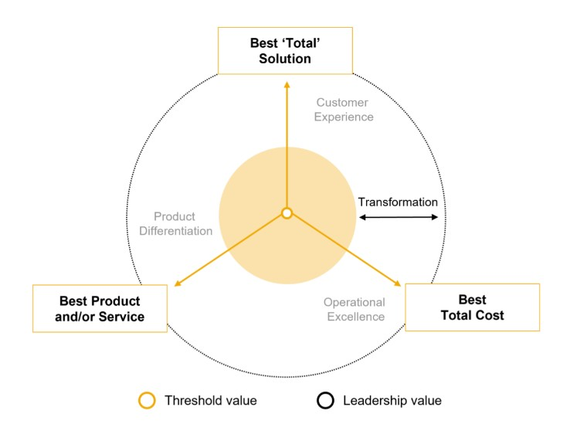
From strategy to execution: how to transform successfully
Business strategy
Business Strategy
Execute on the
company’s business strategy to enable business outcomes
such as increased competitiveness, agility, resilience, transparency, collaboration, and governance.

Slide 25
From strategy to execution: how to transform successfully
Processes
Processes
Ensure customer value-adding, efficient, reliable, and scalable business operations by driving optimization and harmonization in line with compliance and regulatory requirements.

Slide 26
From strategy to execution: how to transform successfully
Processes
Systems
Leverage technology innovation and automation capabilities across core applications and extensibility platforms.

Slide 27
From strategy to execution: how to transform successfully
Processes
People
Collaboration breaks down barriers and is the prerequisite for change.

Slide 28

From strategy to execution: how to transform successfully
Connecting all four dimensions
Business Strategy
Processes
Systems
People

Slide 29







From strategy to Execution: how to transform successfully
End-to-end business process transformation methodology
Processes
Systems
People
EXECUTE PROCESSES & RUN SOLUTIONS
IMPROVE PROCESSES & INNOVATE SOLUTIONS
Analyze Process |  | Enhance Process |  | Design Process |  | Design Solution |  | Build Solution |  | Test Solution
 |  |  |  |  |  |  |  |  |  |  | Deploy Solution
Enable Process

Slide 30
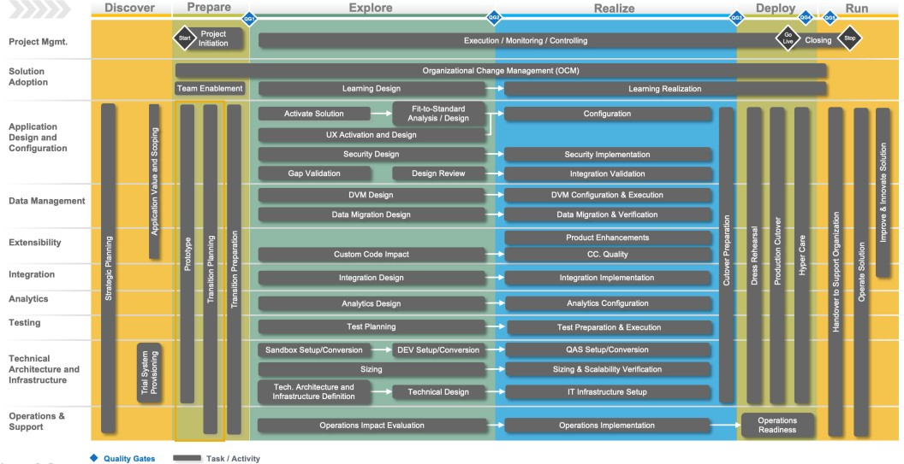
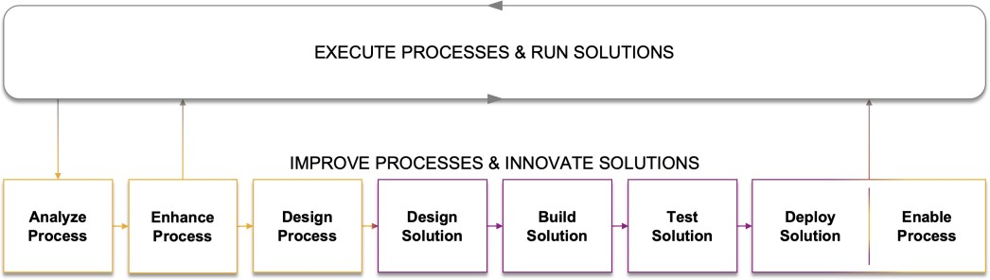
From strategy to execution: how to transform successfully
SAP Activate
SAP Activate provides a clearly guided methodology to deploy, adopt and extend new capabilities across an organization. The SAP Activate Methodology supports the transition to SAP S/4HANA and provides customers for the Discover, Prepare, Explore, Realize, Deploy, and Run phase a set of recommended activities.
SAP Signavio's end-to-end business process transformation methodology is essential in each SAP Activate phase to accelerate the transition, reduce risk and ensure that value is generated during the transition and beyond.

Slide 31
End Day-1

Slide 32

Unit:1-Introduction to Business Transformation with SAP
1.4- Process-Driven and Solution-Driven Transformations

Slide 33
From strategy to execution: how to transform successfully
End-to-end business process transformation methodology
EXECUTE PROCESSES & RUN SOLUTIONS
IMPROVE PROCESSES & INNOVATE SOLUTIONS
Analyze Process |  | Enhance Process |  | Design Process |  | Design Solution |  | Build Solution |  | Test Solution
 |  |  |  |  |  |  |  |  |  |  | Deploy Solution
Enable Process

Slide 34
SAP Signavio Training support every step of your SAP S/4HANA transformation scenario…
Process-driven and solution-driven transformations
Solution-Driven
Transformation
Selective
Transformation
Process-Driven
Transformation
rethink processes*
reuse
processes
reuse processes
rethink processes
rethink
processes
reuse
processes
* triggered by mandatory changes

Slide 35

Process-driven and solution-driven transformations
… and drive process excellence and continuous transformation
rethink processes
Process-Driven Transformation
Selective Transformation
Solution-Driven Transformation
reuse processes
Starting Point
“Legacy”
Initial Leap
SAP S/4HANA
Transformation
Go-Live
Continuous Transformation
Idealistic Target
“North Star”

Slide 36



















Process-driven and solution-driven transformations
The characteristics of the methodology differ depending on the transformation path
Process-Driven
Business Process
Transformation
Analyze
Process
Enhance
Process
Design
Process
Design
Solution
Build
Solution
Test
Solution
Deploy
Solution
Enable
Process
Processes
Systems
People
SAP S/4HANA Implementation
Solution-Driven
Design Process
Design Solution
Build Solution
Test Solution
Deploy Solution
Enable Process
Analyze
Process
Enhance
Process
Like-for-Like System Conversion Incl. Mandatory Changes
Processes
Systems
Design Process
People
Plan Process Improvements & Innovations
Business Process Transformation

Slide 37
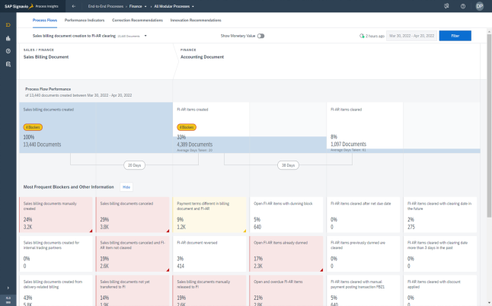
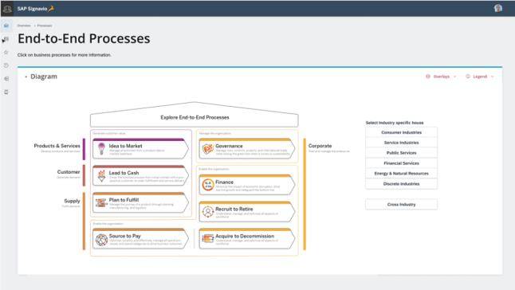
Process-driven and solution-driven transformations
Process-driven transformations (1)
Business Process
Transformation
Analyze
Process
Enhance
Process
Design
Process
Design
Solution
Build
Solution
Test
Solution
Deploy
Solution
Enable
Process
Processes
Systems
People
SAP S/4HANA Implementation
Get fast and deep insights into current process execution
KPI measurement and benchmarking
Data-driven process flow visualization
As-is process analysis (expert exploration)
Derive data-driven optimization potential
Implement correction recommendations already in current
environment (“quick fixes”)
Clean-up of master data (only migrate data that is really required)
Leave behind configured business process variants that are not used
Determine business value and improvement potential
Explore innovation recommendations
Prioritize optimization opportunities
Explore best practice processes and reference architectures
SAP Signavio's Process Insights
SAP Signavio's Process Explorer

Slide 38
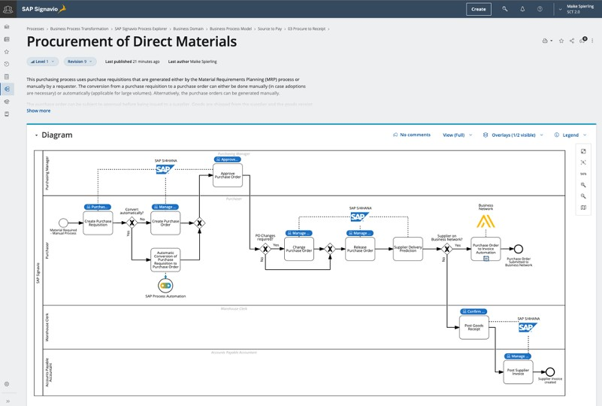
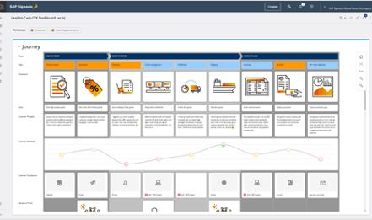
Process-driven and solution-driven transformations
Process-driven transformations (2)
Business Process
Transformation
Analyze
Process
Enhance
Process
Design
Process
Design
Solution
Build
Solution
Test
Solution
Deploy
Solution
Enable
Process
Processes
Systems
People
SAP S/4HANA Implementation
Define and design customer journey
Collaboratively define and model to-be processes
Rethink processes: strong standardization and harmonization potential based on best-practices processes and industry benchmarking
For differentiation processes, improve current as-is processes, get inspiration from best-practice processes, and adapt innovation recommendations
Define business requirement
Approve to-be processes
SAP Signavio's Collaboration Hub
SAP Signavio's Journey Modeler

Slide 39
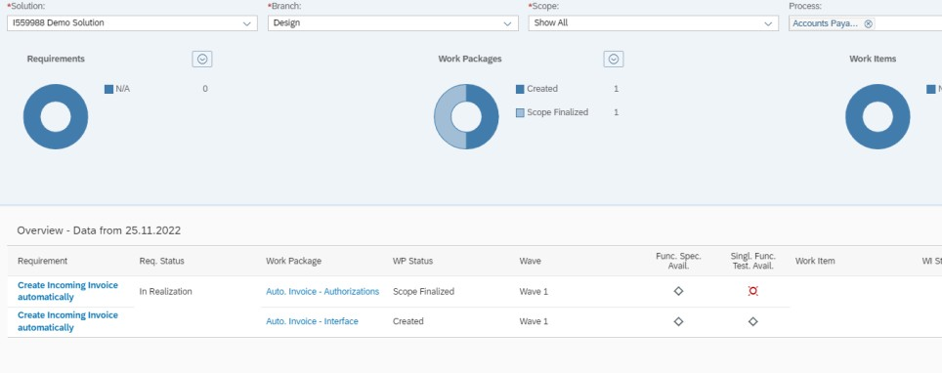
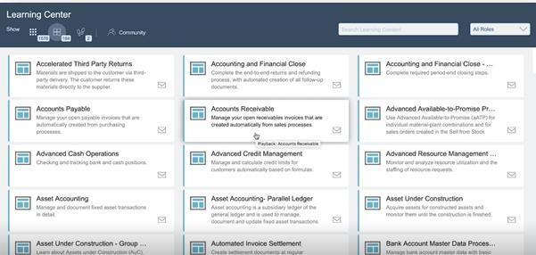
Process-driven and solution-driven transformations
Process-driven transformations (3)
Business Process
Transformation
Analyze
Process
Enhance
Process
Design
Process
Design
Solution
Build
Solution
Test
Solution
Deploy
Solution
Enable
Process
Processes
Systems
People
SAP S/4HANA Implementation
Handover of business requirement to solution
architects. Translate changes into solution design
Perform solution changes trough backlog and DevOps pipeline:
Implement new processes, perform system changes (e.g. customizing)
Prepare user acceptance testing and execute
process-oriented testing
Approve solution
Enable the business to execute the new process in an efficient way running on the new solution
(change management)
Perform go-live
Solution Manager – Focused Build
SAP Enable Now

Slide 40
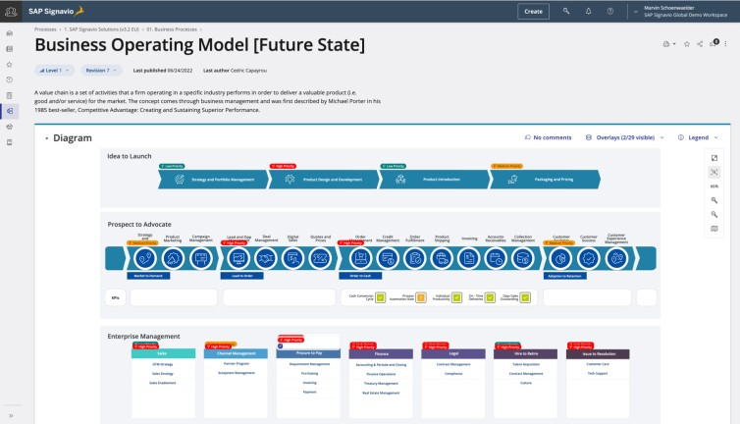
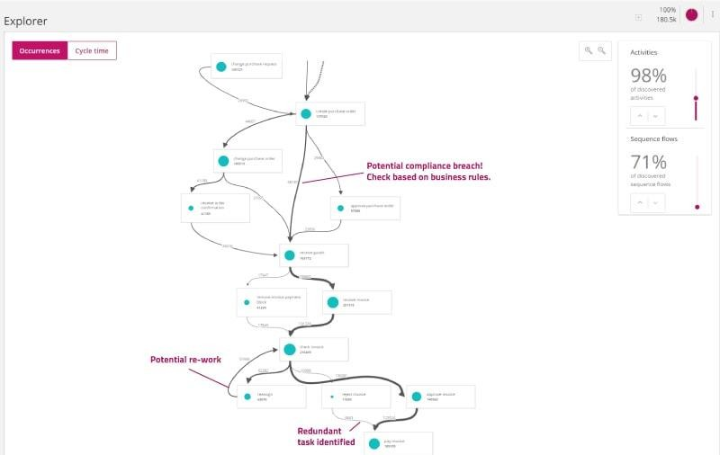
Process-driven and solution-driven transformations
Process-driven transformations (4)
Business Process
Transformation
Analyze
Process
Enhance
Process
Design
Process
Design
Solution
Build
Solution
Test
Solution
Deploy
Solution
Enable
Process
Processes
Systems
People
SAP S/4HANA Implementation
Continuously optimize your new processes by
…
getting fast and deep insights into new
process execution
collaboratively rethinking and redesigning your business processes
defining new business requirements and
innovating solutions
SAP Signavio's Process Collaboration Hub
SAP Signavio's Process Intelligence

Slide 41
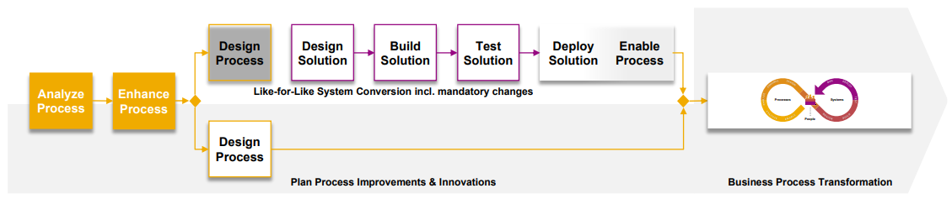
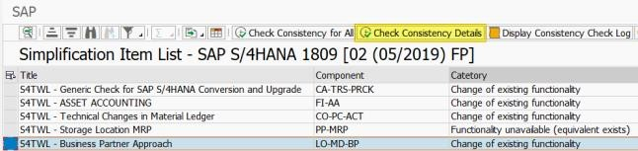
Process-driven and solution-driven transformations
Solution-driven transformations (1)
Analyze processes that require re-design due to mandatory changes and beyond to identify further process improvements
Derive data-driven optimization potential in preparation for the transition to SAP S/4HANA
Implement correction recommendations already in current environment (“quick fixes”)
Clean-up of master data (only migrate data that is really required)
Determine business value and improvement potential
Explore innovation recommendations
Prioritize optimization opportunities
SAP Signavio's Process Insights
SAP S/4HANA: Simplification Item Check

Slide 42
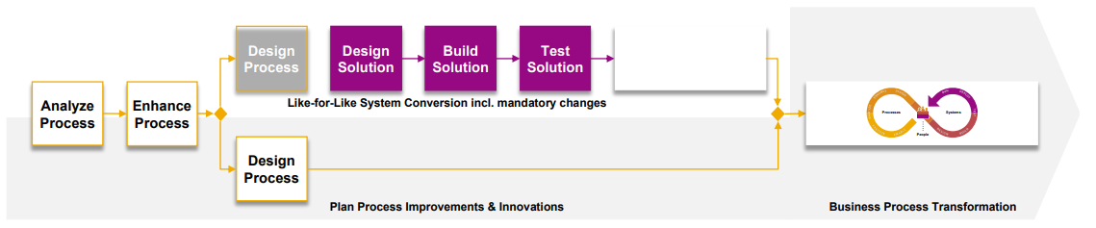
Process-driven and solution-driven transformations
Solution-driven transformations (2)
For all “reused” processes, perform like-for-like system conversion
For processes affected by mandatory changes or where you identified improvement potential, collaboratively define and model to-be processes, perform solution changes through your backlog and DevOps pipeline: Implement new processes, perform system changes (e.g., customizing)
Prepare user acceptance testing and execute process-oriented testing
Approve solution
Enable the business in executing the (new) process running on
the new solution
Perform go-live
Solution Manager – Focused Build
SAP Enable Now

Slide 43
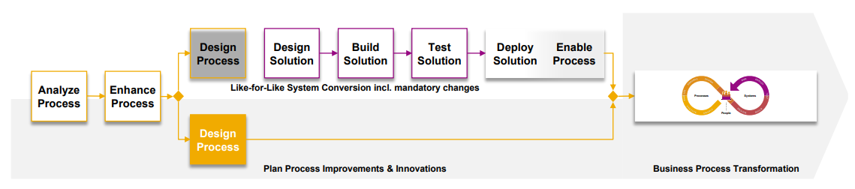
Process-driven and solution-driven transformations
Solution-driven transformations (3)
In parallel, establish a process mindset to leverage
SAP S/4HANA innovations, plan and prioritize future process improvements and innovations
For selected processes:
Collaboratively define and model to-be processes
Rethink processes iteratively. Focus on standardization and harmonization potential based on best-practices processes. Consider (industry) benchmarking
Define E2E journeys establishing an outside-in perspective
SAP Signavio's Process
Collaboration Hub
SAP Signavio's Journey Modeler

Slide 44
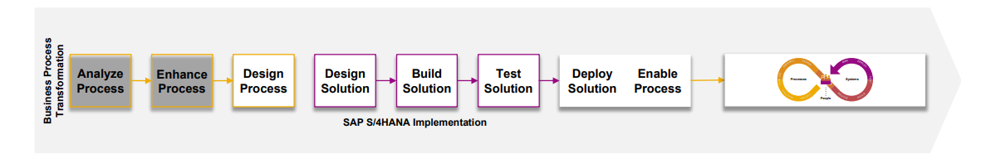
Process-driven and solution-driven transformations
Solution-driven transformations (4)
Continuously optimize your new processes by …
getting fast and deep insights into new process execution
collaboratively rethinking and redesigning your
business processes
defining new business requirements and
innovating solutions
SAP Signavio's Process Collaboration Hub
SAP Signavio's Process Intelligence

Slide 45

Unit:1- Introduction to Business Transformation with SAP
1.5- How SAP Signavio Training Drive SAP S/4HANA Transformations

Slide 46
How SAP Signavio Training drive SAP S/4HANA transformations
End-to-end business process transformation methodology
Process-Driven
Business Process
Transformation
Analyze
Process
Enhance
Process
Design
Process
Design
Solution
Build
Solution
Test
Solution
Deploy
Solution
Enable
Process
Processes
Systems
People
SAP S/4HANA Implementation
Solution-Driven
Design Process
Design Solution
Build Solution
Test Solution
Deploy Solution
Enable Process
Analyze
Process
Enhance
Process
Like-for-Like System Conversion Incl. Mandatory Changes
Processes
Systems
Design Process
People
Plan Process Improvements & Innovations
Business Process Transformation

Slide 47




Continuously improve your processes
How SAP Signavio Training drive SAP S/4HANA transformations
Processes
Systems
People

Slide 48






SAP Signavio's: a process transformation suite for collaborative change
How SAP Signavio Training drive SAP S/4HANA transformations
SAP Signavio's Process Collaboration Hub
SAP Signavio's Process Explorer
SAP Signavio's Process Insights
2
1
SAP Signavio's Process Intelligence
4
SAP Signavio's Journey Modeler
3
2
Processes
Sys
SAP Signavio's Process Manager
1
5
SAP Signavio's Process Governance
3
People
SAP Build Process Automation
4
SAP SolMan (ALM) and
LeanIX (EAM) Integration
5

Slide 49




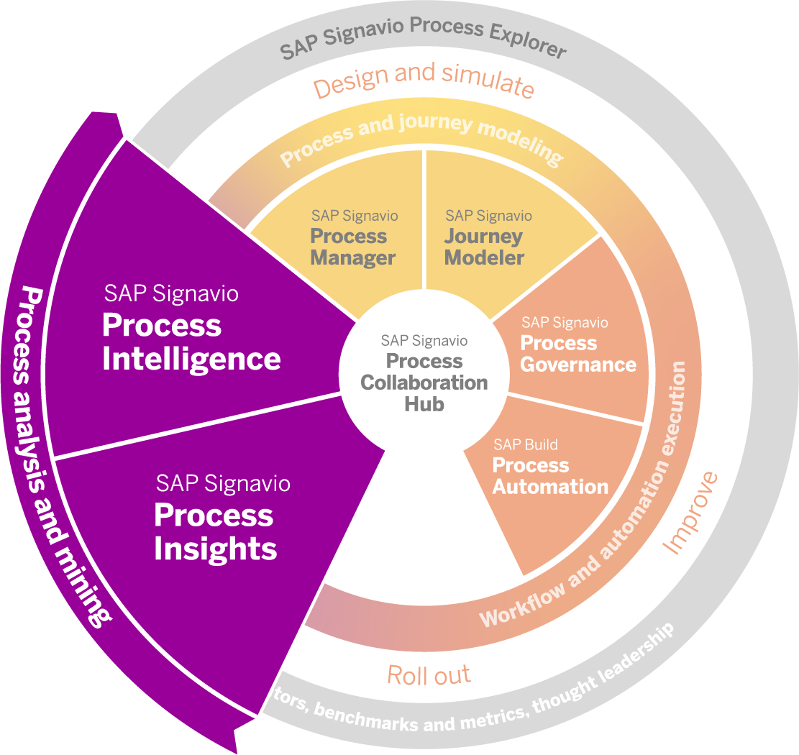
Process analysis and mining
How SAP Signavio Training drive SAP S/4HANA transformations
1
Processes
Syst
People
Understand your current process performance to determine improvement potential (value) and derive recommendations on how to re-design your processes
Measure your processes post SAP S/4HANA transformation to determine if improvement potential has been realized and to enter a continuous process improvement cycle

Slide 50
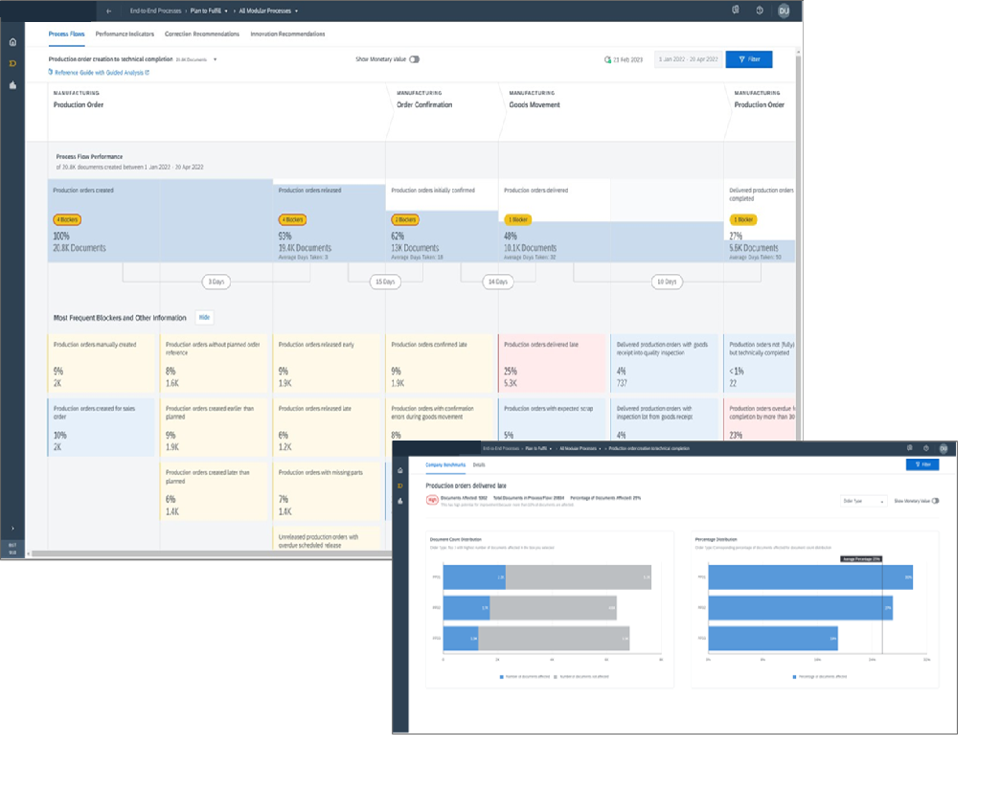



How SAP Signavio Training drive SAP S/4HANA transformations
SAP Signavio's Process Insights
Immediate process
performance insights
Benchmark your processes
Start improving
right away

Slide 51
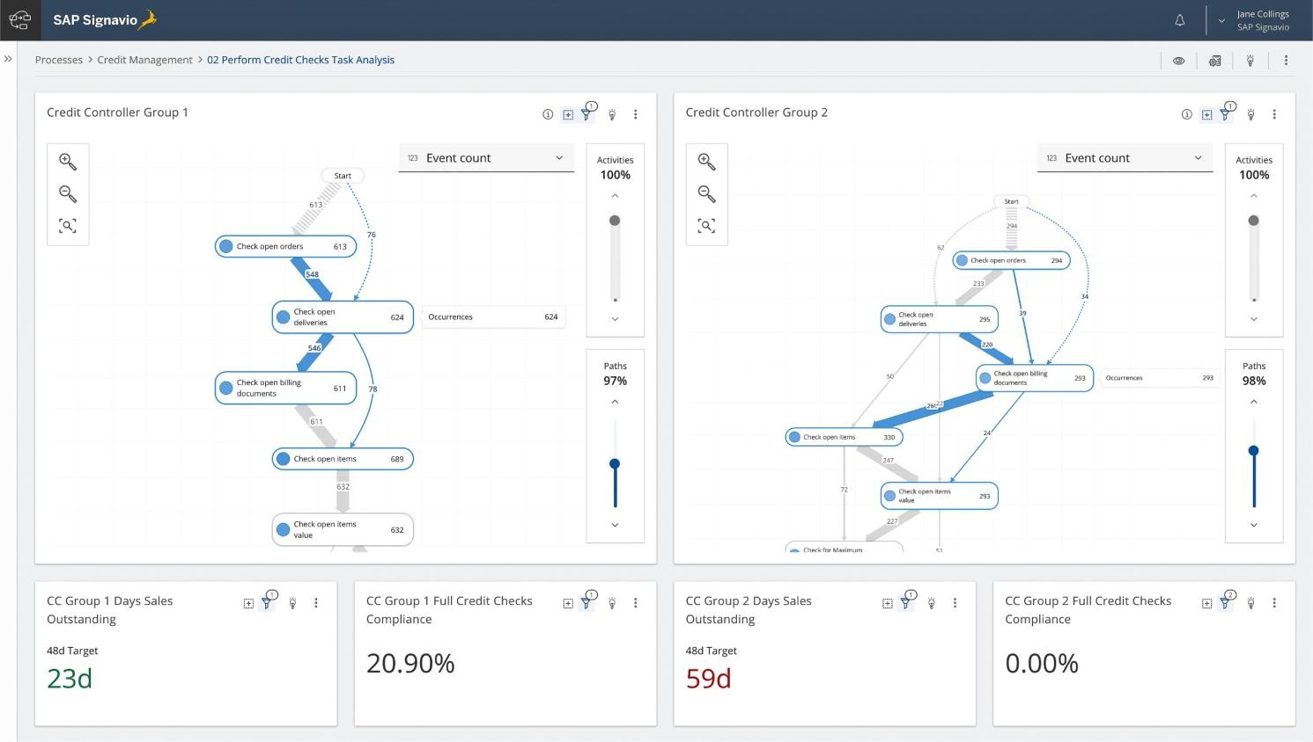



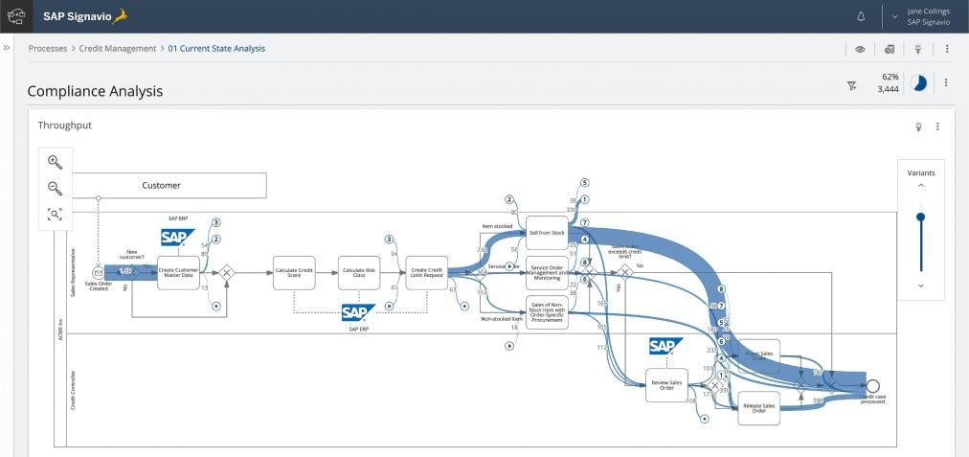

How SAP Signavio Training drive SAP S/4HANA transformations
SAP Signavio's Process Intelligence
Process data
management
Analytics and visualizations
Process analysis engine
Insights management and collaboration

Slide 52
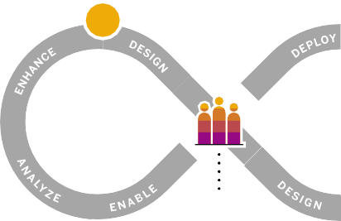
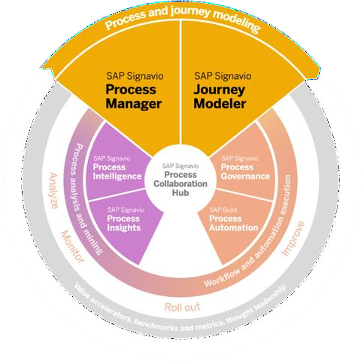
How SAP Signavio Training drive SAP S/4HANA transformations
Process and journey modeling
2
Processes
Syst
People
Design your processes considering current process performance, innovation recommendations, and best practices to lay the foundation for system design, testing, and enablement
Make customer, partner, and employee experiences understandable and drive process re-thinking by eliminating silos

Slide 53
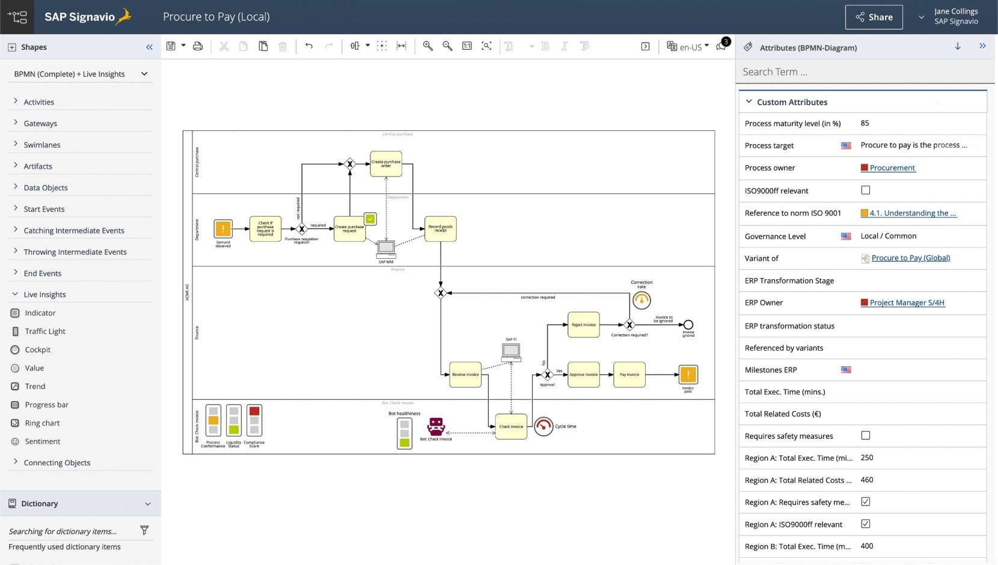





How SAP Signavio Training drive SAP S/4HANA transformations
SAP Signavio's Process Manager
Collaborative process modeling
Configurable modeling conventions
Process documentation
and reporting
Quick modeling
Process simulation

Slide 54
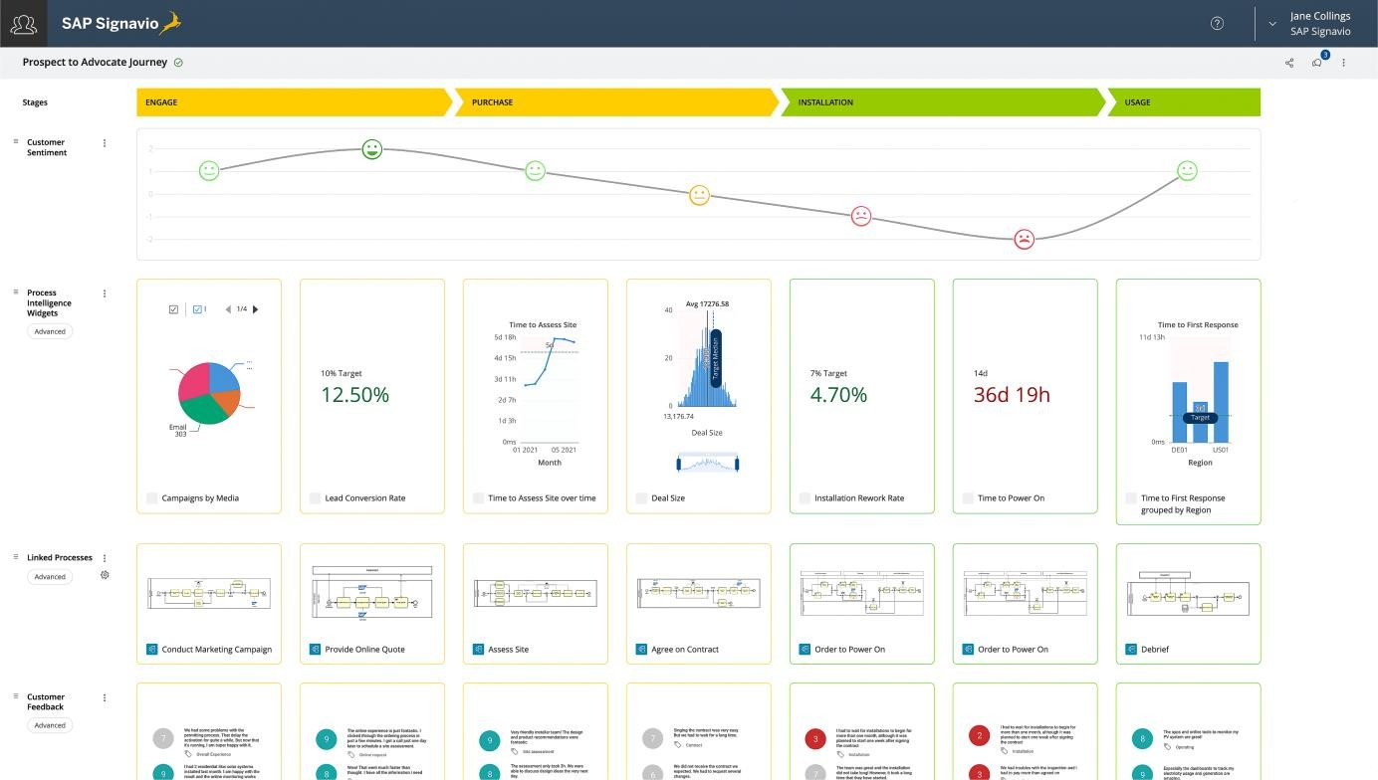

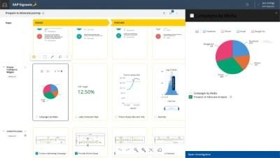


How SAP Signavio Training drive SAP S/4HANA transformations
SAP Signavio's Journey Modeler
Collaborative
journey modeling
Design journey models Connecting data
with experience
Business repository integration
Reusing domain objects for personas and touchpoints

Slide 55
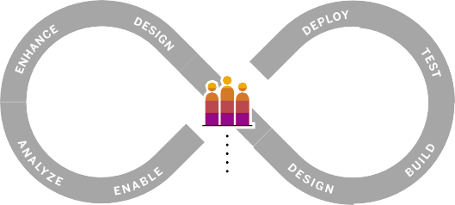

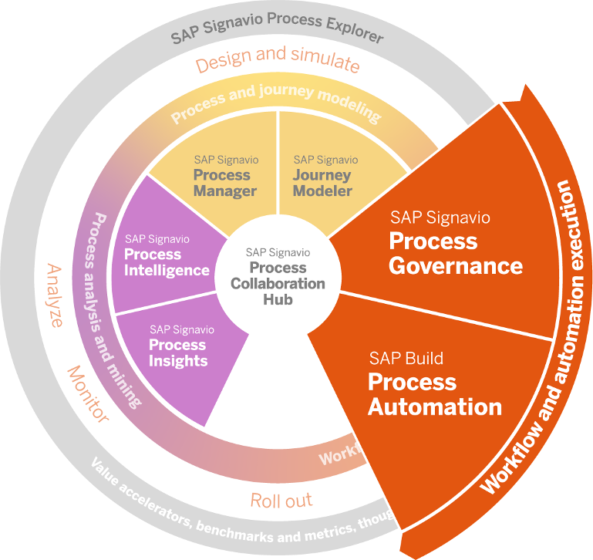
Workflow and automation execution
How SAP Signavio Training drive SAP S/4HANA transformations
4
3
Systems
Processes
People
Establish a process governance to keep control of
your processes involving the required stakeholders and process owners
Improve processes beyond SAP S/4HANA standard capabilities based on defined end-to-end processes

Slide 56

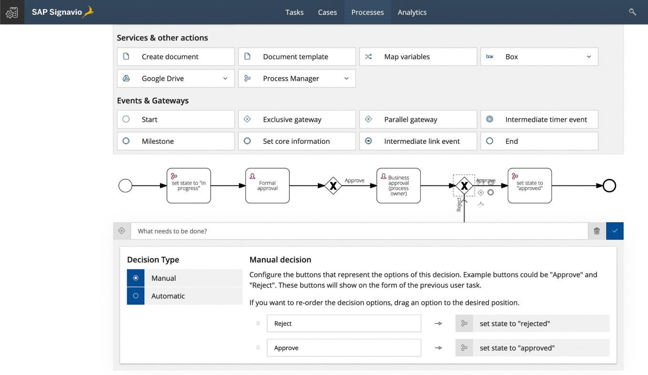



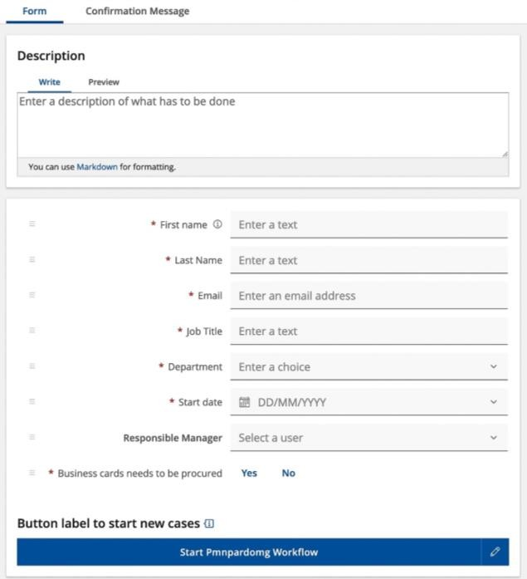


How SAP Signavio Training drive SAP S/4HANA transformations
SAP Signavio's Process Governance
Process release cycle management
Process maturity assessment
Process-integrated risk and control management
Configurable workflow builder

Slide 57

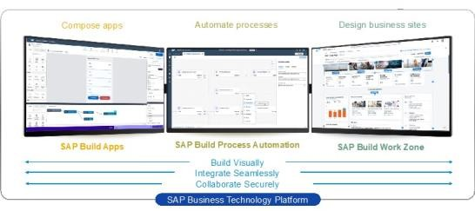


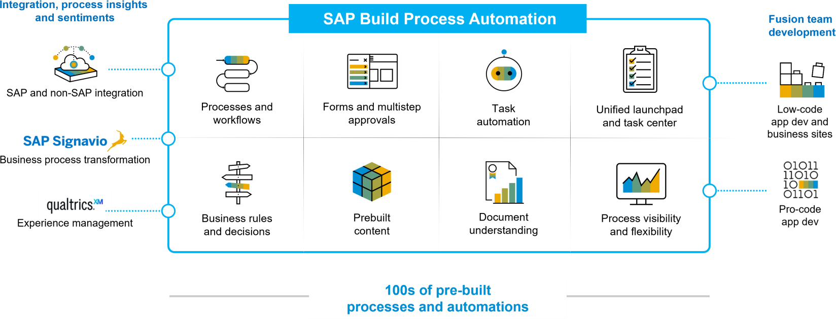

How SAP Signavio Training drive SAP S/4HANA transformations
SAP Build Process Automation
Create forms, manage logic and build process flows
Automate repetitive manual tasks
SAP Build Process Automation
Document
understanding

Slide 58
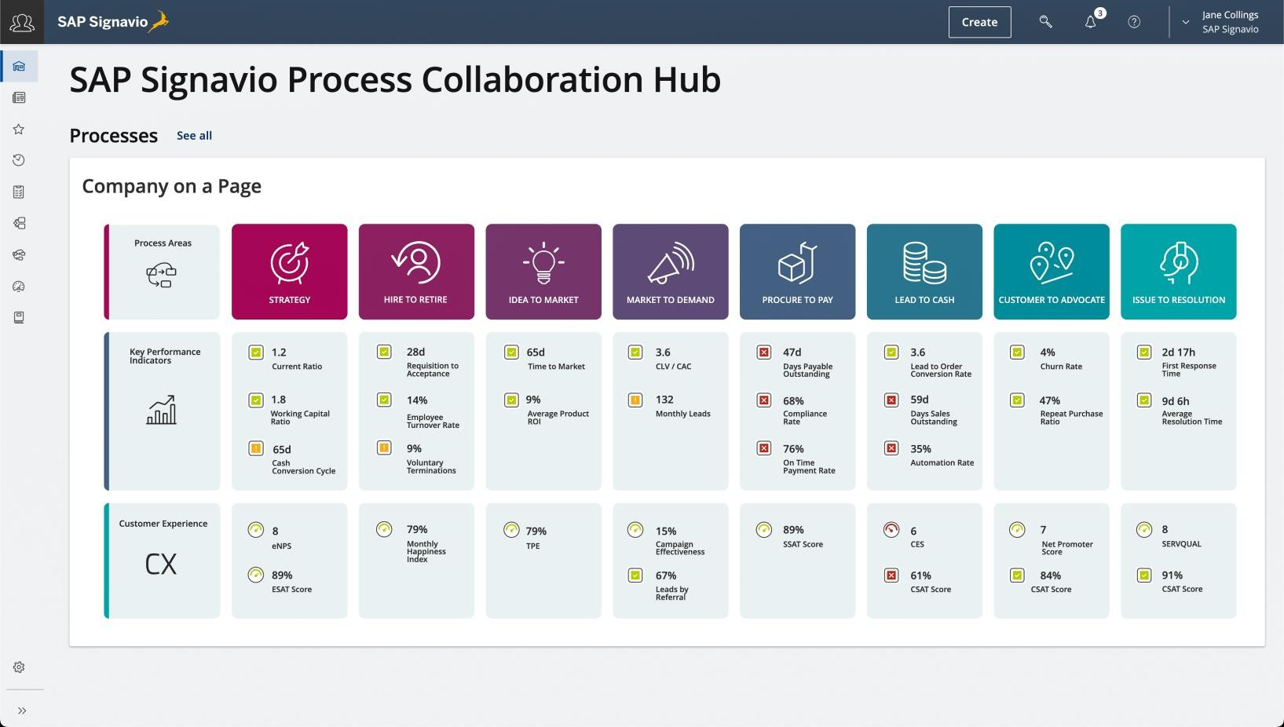



How SAP Signavio Training drive SAP S/4HANA transformations
SAP Signavio’s Process Collaboration Hub
Inform the entire organization about processes
Guide employees with navigation maps
Provide access to all SAP Signavio's solutions

Slide 59

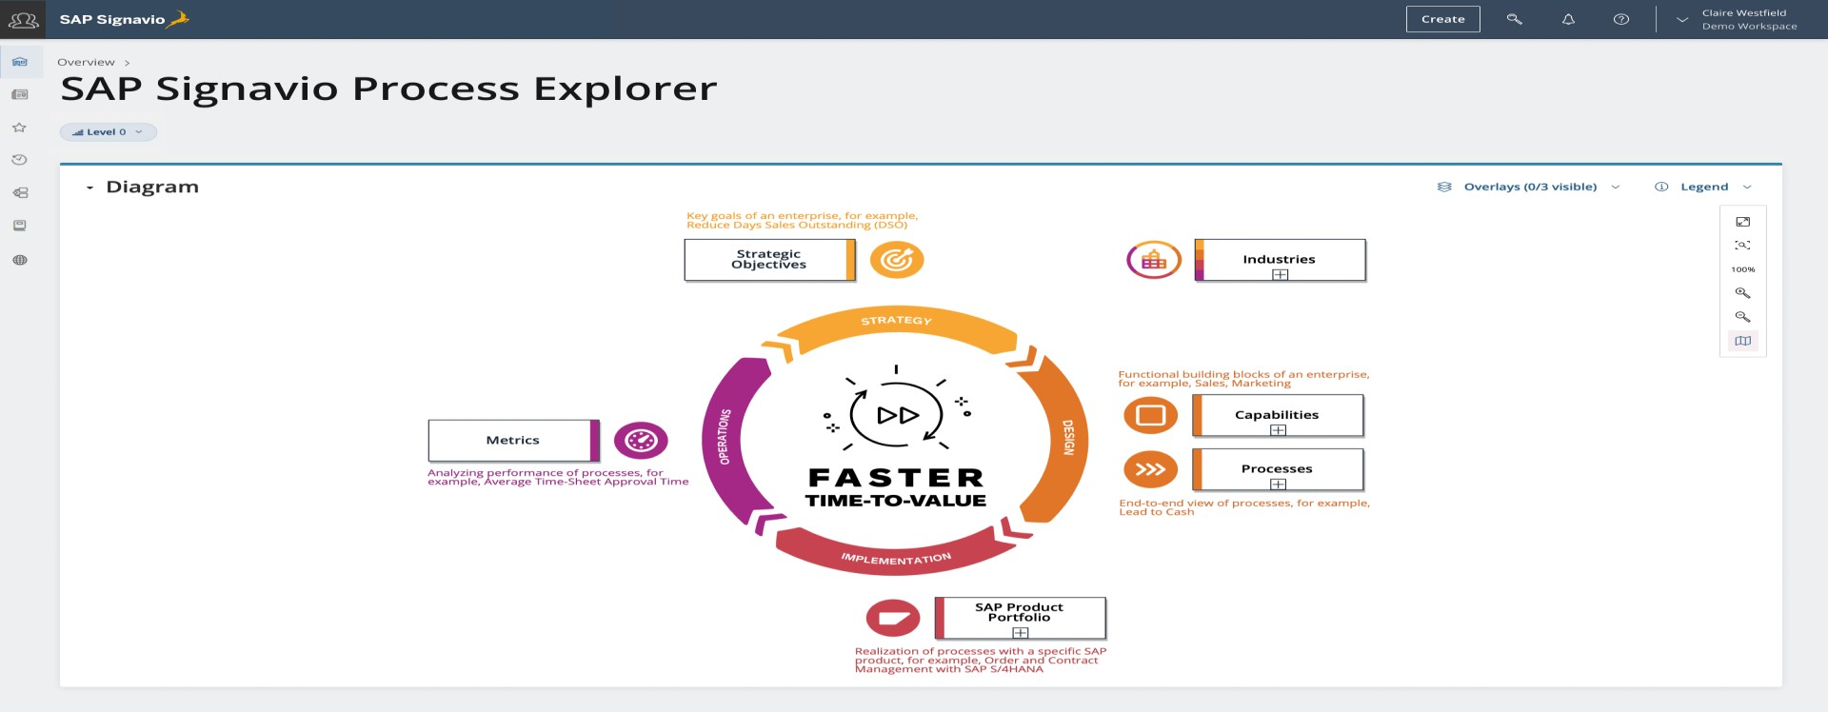





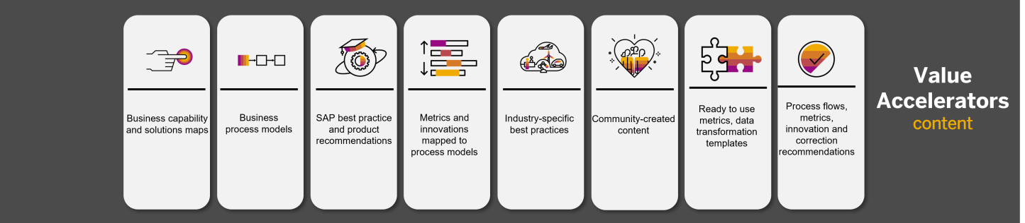
How SAP Signavio Training drive SAP S/4HANA transformations
SAP Signavio's Process Explorer
Ready-to-use
metrics
Reference business architectures
Preconfigured
process models
Product best practices and innovation recommendations

Slide 60
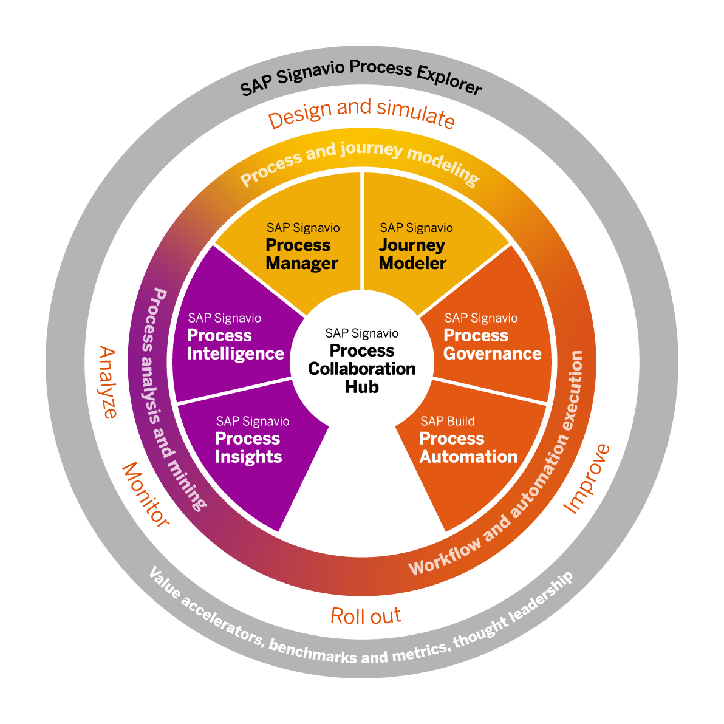
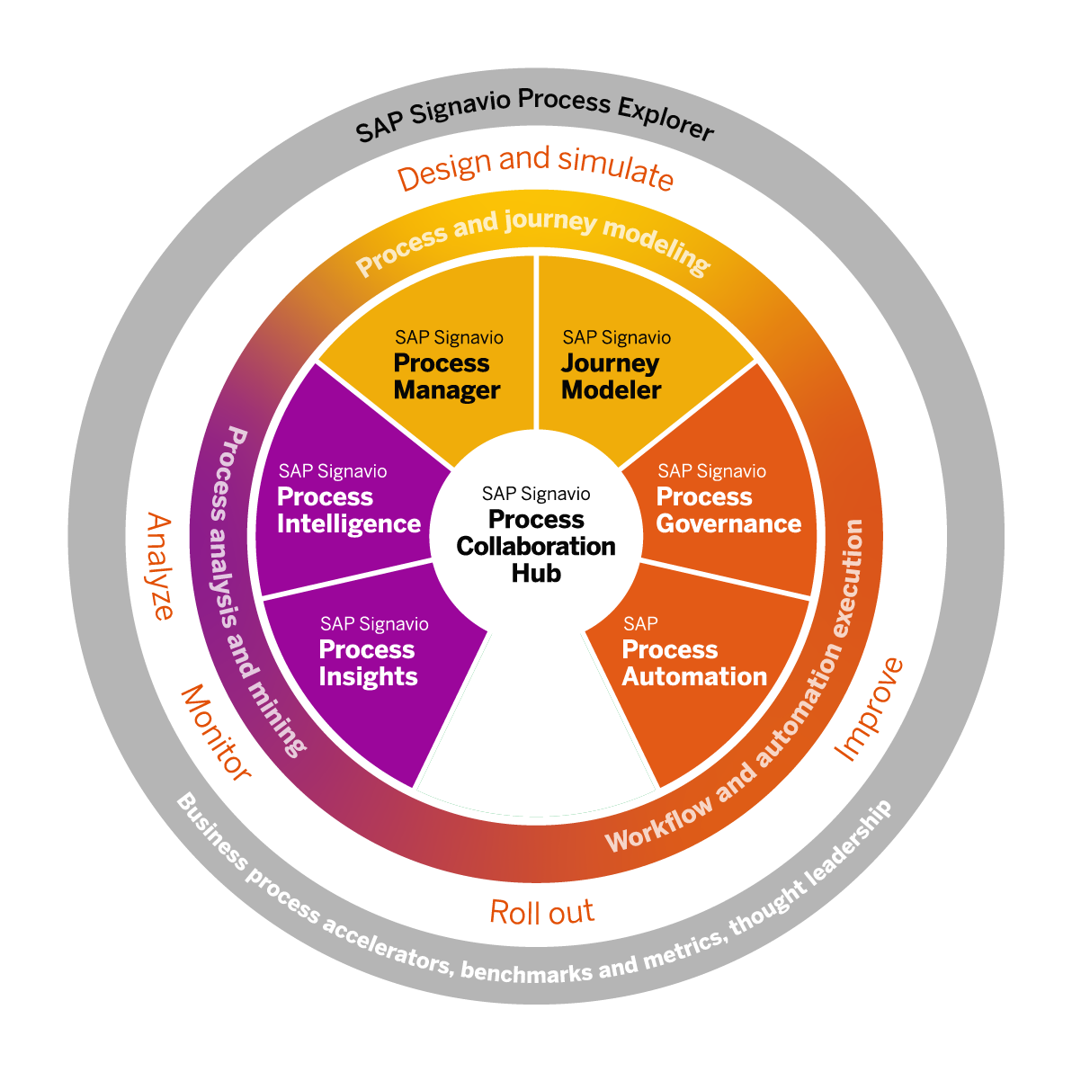
SAP Signavio's Process Transformation Suite
How SAP Signavio Training drive SAP S/4HANA transformations
A cloud-based process transformation suite that gives companies the ability to understand, improve, and transform all of their (end-to-end) business processes, fast and at scale
(Across SAP and non-SAP solutions)

Slide 61


Do You Have Any Questions

Slide 62


Anubhav Oberoy

Slide 63





We build the workforce of the future.​
We’re committed to empowering you
to be​ the Most Desirable Resource​
through powerful training solutions.​
250+
Corporate Clients
30000+ Learned Trained
25000+ Learned Placed
Enroll Now
www.anubhavtrainings.com
FREE WEBINARS ​
Sign up for free webinars with industry experts every fortnight!

